Slide 1
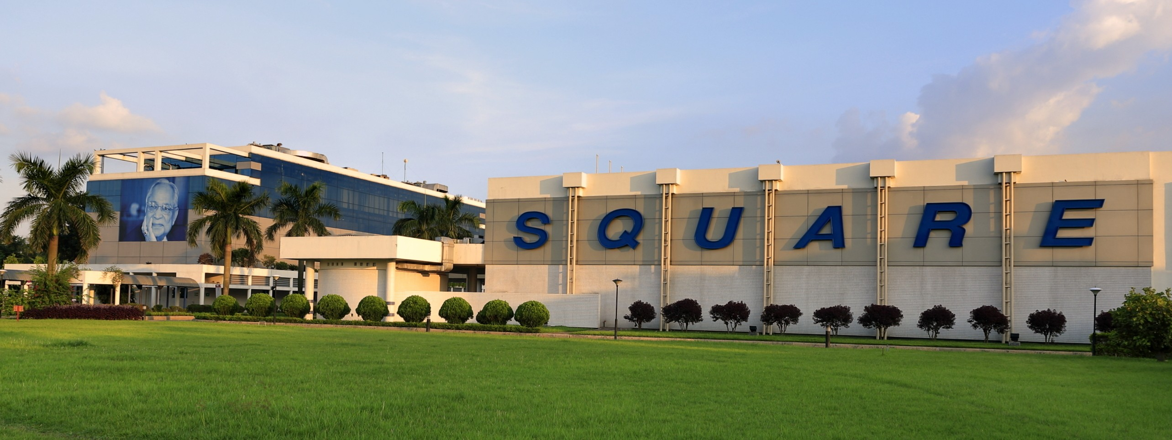
WeLCOME TO MY PRESENTATION

Slide 2
My Presentation Topic is Square Pharmaceuticals Limited

Slide 3
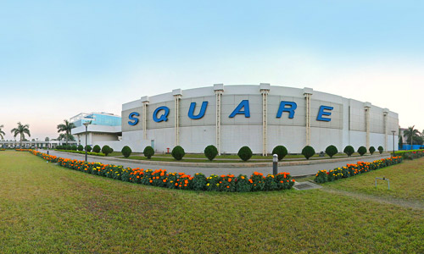
About us
SQUARE Pharmaceuticals PLC. is the largest pharmaceutical company in Bangladesh and it has been continuously in the 1st position among all national and multinational companies since 1985. It was established in 1958, converted into a public limited company in 1991 and listed with stock exchanges in 1995. The turnover of Square Pharma was BDT 50.87 Billion (US$ 609.18 million) with about 16.95% market share having a growth rate of about 10.85% (July 2018– June 2019).

Slide 4
Company overview
Square Pharmaceuticals LTD. headquarters in Gazipur
Company type | Private
Traded as | DSE: SQURPHARMA CSE: SQURPHARMA
Industry | Pharmaceutical
Founded | 1958
Founder | Samson H. Chowdhury
Headquarters | Mohakhali, Dhaka , Bangladesh
Area served | Asia, Africa, Europe, Central America, South America, Australia
Key people | Tapan Chowdhury (CEO)
Revenue | US$528 million (2019)
Operating income | US$254 million (2019)
Net income | US$156 million (2019)
Total assets | US$1.18 billion (2019)
Number of employees | 7390 (2016-17)
Parent | Square Group
Website | squarepharma.com.bd

Slide 5
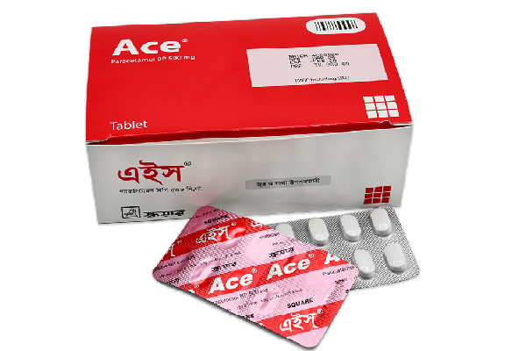
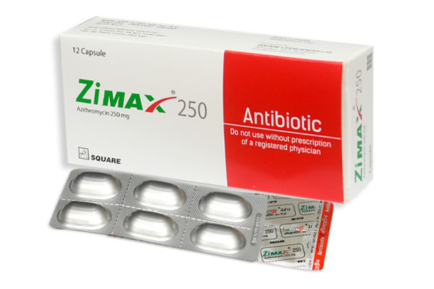
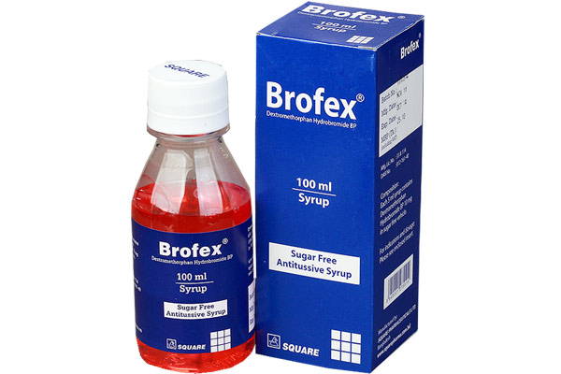
Product overview
Square Pharmaceuticals Limited is a leading pharmaceutical company, primarily based in Bangladesh, and recognized for its commitment to innovation, quality, and accessibility. It operates in multiple therapeutic categories and has an extensive portfolio of products designed to meet healthcare needs across various segments.

Slide 6
Advantage
Strong Market Leadership
Comprehensive Product Portfolio
High-Quality Standards
Strong Research and Development (R&D)
Export Leadership
Skilled Workforce
Financial Strength
Technological Advancements
Corporate Social Responsibility (CSR)
Diversification
Visionary Leadership
Sustainability Practices

Slide 7
Poroduct Benefit
Square Pharmaceuticals is a pharmaceutical company in Bangladesh that offers a range of products, including:
Generic medicines: Square Pharmaceuticals focuses on producing and distributing affordable generic medicines to meet the needs of the price-sensitive Bangladeshi market.
Herbal and nutraceuticals: Square Pharmaceuticals offers a range of herbal products, including traditional Ayurvedic medicines, vitamins, and mineral supplements.
Antibiotics and other pharmaceutical products: Square Pharmaceuticals exports antibiotics and other pharmaceutical products to 42 countries.
Skin preparations: Square Pharmaceuticals offers products such as De-rash Plus, Isotrin, and Otic-4.
Antidiabetic preparations: Square Pharmaceuticals offers products such as Dumeg and RapiMix.
Antibacterials: Square Pharmaceuticals offers products such as Tezo.
Antianemic drugs: Square Pharmaceuticals offers products such as Femotol and Renustat.
Eye preparations: Square Pharmaceuticals offers products such as Trevox D.
Non-narcotic analgesics: Square Pharmaceuticals offers products such as Neumig.
Anti-gout preparations: Square Pharmaceuticals offers products such as Dotfix.
NSAIDs: Square Pharmaceuticals offers products such as Lorno.
Cephalosporin antibiotics: Square Pharmaceuticals offers products such as Avitaz.

Slide 8

Our competition
Our product is priced below that of other companies on the market
Design is simple and easy to use, compared to the complex designs of the competitors
Affordability is the main draw for our consumers to our product
Company A product is more expensive
Companies B & C product is expensive and inconvenient to use
Companies D & E product is affordable, but inconvenient to use

Slide 9

Financials
 | Year 1 | Year 2 | Year 3
Income
Users | 50,000 | 400,000 | 1,600,000
Sales | 500,000 | 4,000,000 | 16,000,000
Average price per sale | 75 | 80 | 90
Revenue @ 15% | 5,625,000 | 48,000,000 | 216,000,000
Gross profit | 5,625,000 | 48,000,000 | 216,000,000

Slide 10


